Slide 1
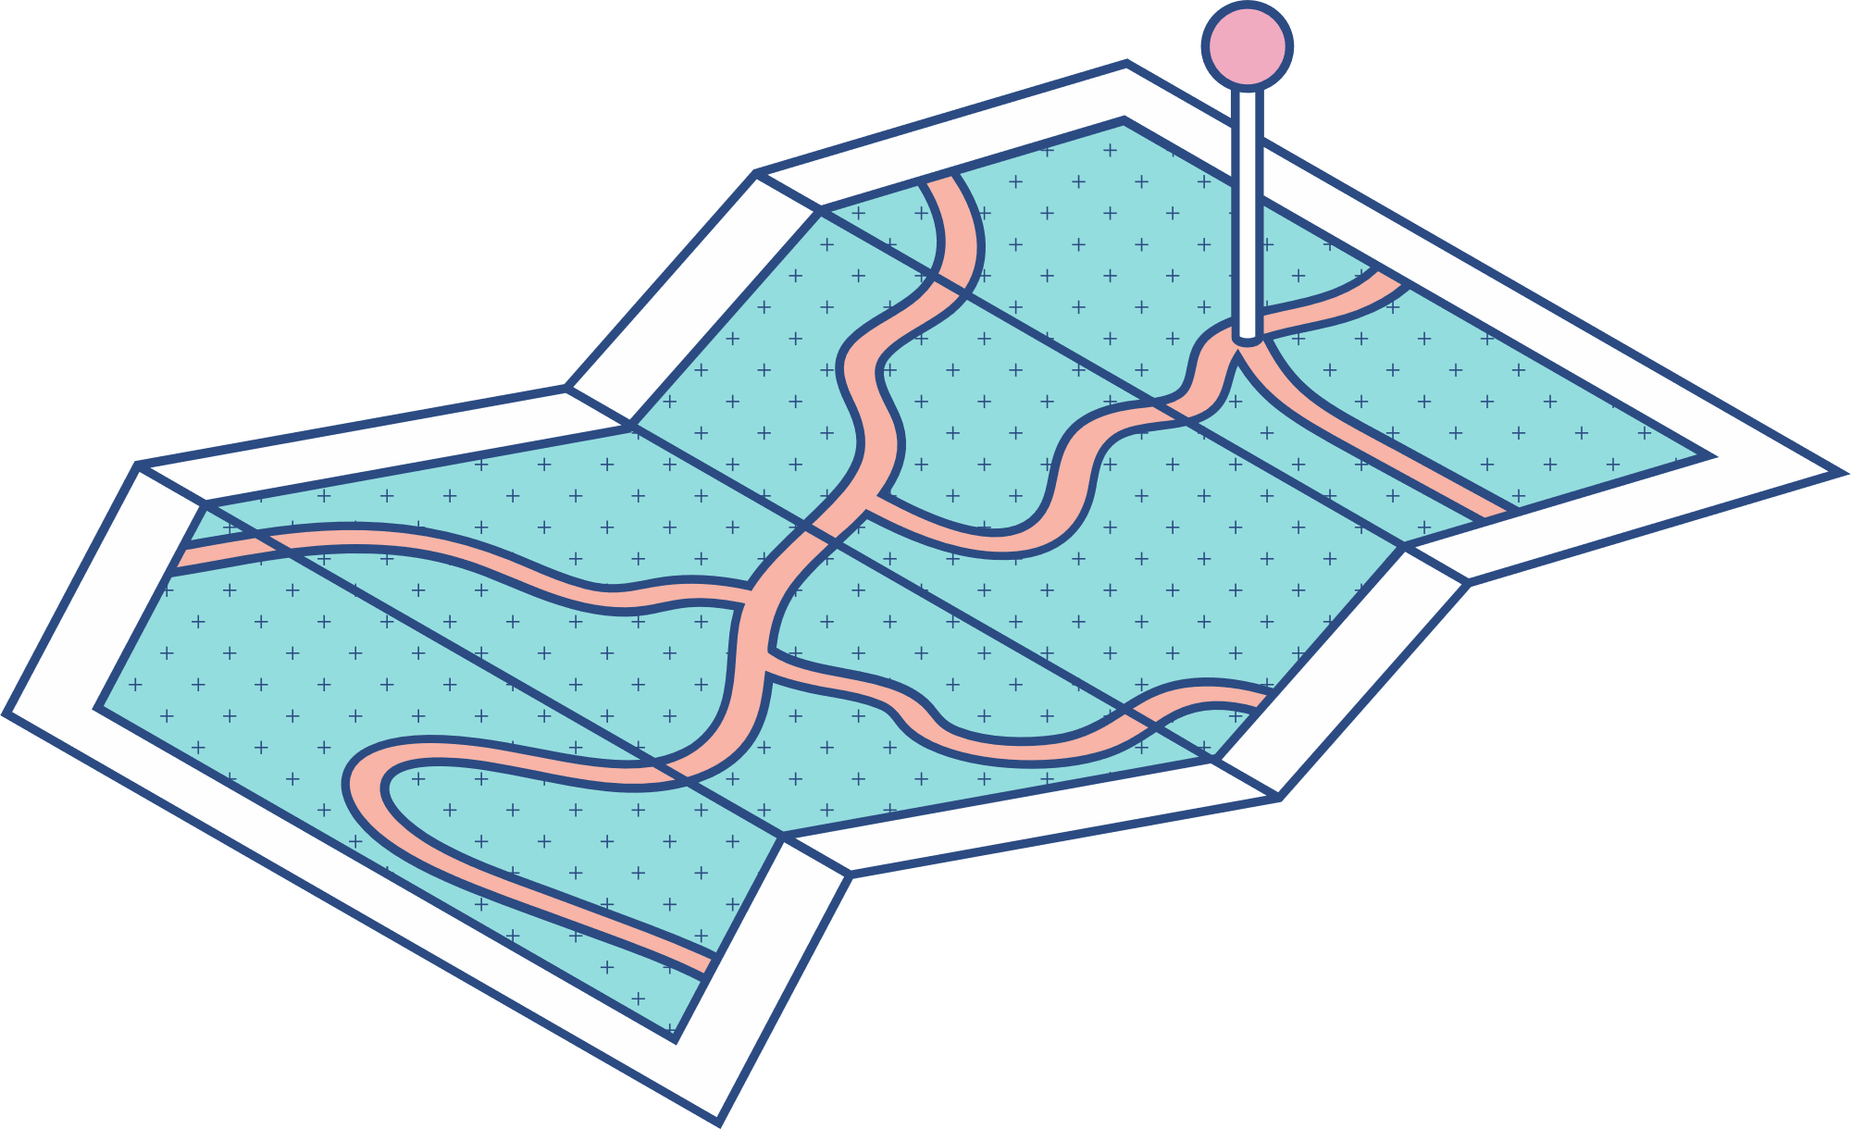





SQL Group Presentation
Avengers
Sai Priya Kaipu
Nitika
Sai Kiran Varada
Harmanpreet Singh
Khemraj Dahal
Qi Guo

Slide 2



Agenda Introduction Individual Tasks ERD ID’s(Primary and Foreign key) Joins Aspects undertaken Key Takeaways

Slide 3

Introduction
Purpose of Presentation:
This presentation aims to provide an overview of the interconnected database schema for the Sales and Production databases.
Significance of Databases and Relationships:
The Sales database plays a critical role in managing customer data, orders, and staff information vital for effective business operations.
The Production database holds key information regarding brands, categories, products, and stocks, influencing product management and sales.
Highlighting the relationships between these databases showcases how data seamlessly flows to support various business processes.
Key Components Covered in Schema:
Sales Database and their Tables (Customers, Staffs, Stores, Orders, Order Items).
Production Database and their Tables(Brands, Categories, Products, Stocks).

Slide 4

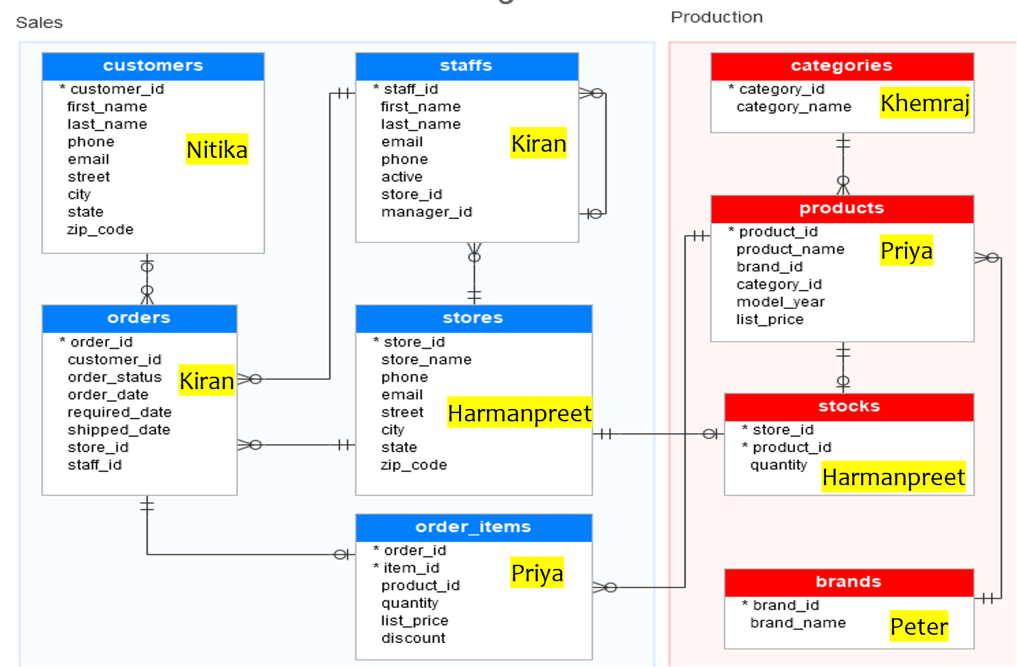
Individual Tasks

Slide 5

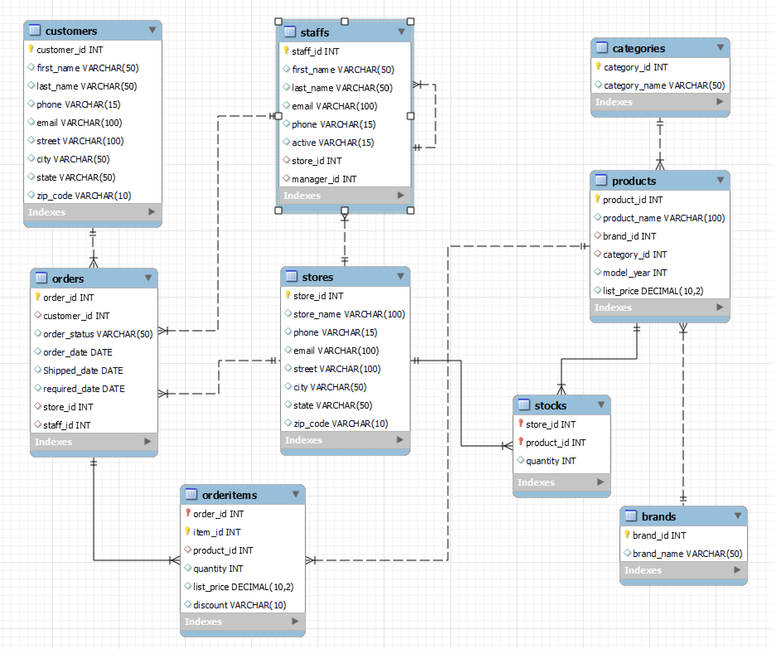
ER Diagram

Slide 6

ID’s (Primary key and Foreign key)
Data Base | Table | Primary Key | Foreign Key
Sales
 | customers | customer_id
 | stores | store_id
 | staffs | staff_id | store_id
 |  |  | manager_id
 | orders | order_id | customer_id
 |  |  | store_id
 |  |  | staff_id
 | orderitems | order_id | order_id
 |  | item_id | product_id
Production
 | Brands | brand_id
 | categories | category_id
 | products | product_id | brand_id
 |  |  | category_id
 | stocks
 |  | store_id | store_id
 |  | product_id | product_id

Slide 7
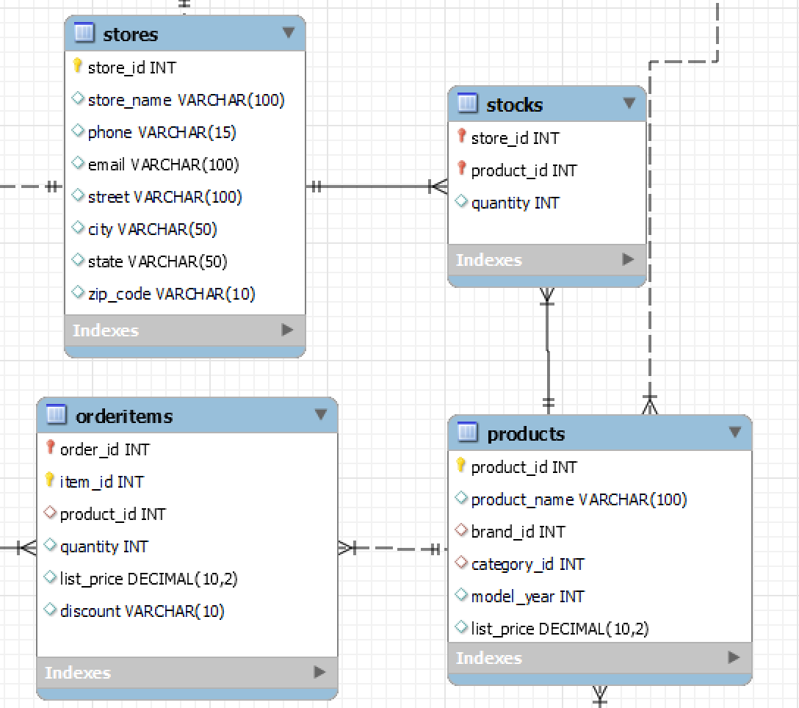
Joins (Relation between Databases)
The databases Sales and Production are joined through the following tables:
Scenario 1:
The Production.Stocks table stores information about the different stores (store_id) from the Sales.Stores table.
The Production.Stocks table has foreign keys referencing store_id from Sales.Stores
Through this connection, the Production database and Sales database are indirectly linked.
The Production.Stocks table holds data about products in different stores
Scenario 2:
The Production.Products table contains information about different products, including their unique product_id.
The Sales.OrderItems table stores details of items within orders, including the product_id of each item.
The Sales.OrderItems table has a foreign key referencing product_id from the Production.Products table.
This relationship allows the Sales database to access and utilize information from the Production database regarding the products that are part of different orders.
Production
Sales

Slide 8
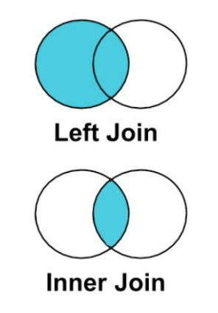
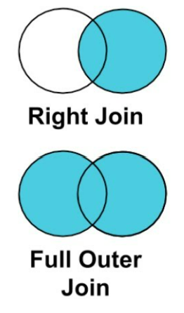
Joins (Relation between Tables)
Different types of joins can be used to retrieve data from these tables based on relationships between them. Here are some common types of joins and how they can be applied to these tables:
Production.Products table has foreign keys referencing Production.Brands and Production.Categories.
This involves two inner joins when querying the product details with brand and category information.
Production.Stocks table has foreign keys referencing Sales.Stores and Production.Products.
This involves inner joins when querying the stock details with the store and to retrieve all products and their stock information.
Sales.Staffs table has a foreign key referencing itself (manager_id) and another foreign key referencing Sales.Stores.
This involves one inner join when querying the staff details with manager information.
Sales.Orders table has foreign keys referencing Sales.Customers, Sales.Stores, and Sales.Staffs.
This involves three inner joins when querying the order details with customer, store, and staff information.
Sales.OrderItems table has a foreign key referencing Sales.Orders and another foreign key referencing Production.Products.
This involves a inner join and a left join when querying the order item details with order and product information.

Slide 9
Aspects Undertaken
Database Creation:
The establishment of Sales and Production databases provides a foundational structure for data organization.
Table Creation:
Creation of tables such as Brands, Categories, and Products facilitates systematic storage of various data entities.
Data types:
Defines the kind of data stored in a database, specifying the format and size. In the provided schema the most used data types are:
INT (Integer) is used for whole numbers, essential for unique IDs like brand IDs etc..
VARCHAR defines variable-length character strings, accommodating flexible data lengths for names, emails, and addresses.
DECIMAL(10, 2) is used for precise decimal numbers, ensuring accuracy for storing prices in the schema.
Primary Keys:
The introduction of primary keys ensures the uniqueness of records within each table, a fundamental principle for data integrity.
Foreign Keys:
Implementation of foreign keys implements relationships between tables, supporting referential integrity in the database design.
Joins:
Using SQL joins link tables together using their relationships, helping to gather complete information from multiple tables based on their connections.

Slide 10

Key Takeaways
We got to understand databases and their types
DDL, DML, and Stored Procedures
SQL syntax fundamentals.
Data querying with CRUD
Filtering and sorting the data by using operators
Usage of Data types
How to determine Primary and Foreign Keys
How to use Joins between tables

Slide 11
Thank you

